Slide 1
Unit 2 – Introduction to python programming language

Slide 2
Contents
About Python
Downloading and setting up python
Variables and Numbers
Data types
User Input
Operators and Expressions
Conditional Statements
Looping Structures
Lists, Tuples and Dictionaries
Type Conversions
Function declaration, calling functions and passing values, Function Returning values and Exiting from functions
Reading/Writing to File.

Slide 3
About Python
Python is an easy to learn, powerful programming language.
It has efficient high-level data structures and a simple but effective approach to object-oriented programming.
Python's elegant syntax and dynamic typing, together with its interpreted nature, make it an ideal language for scripting and rapid application development in many areas on most platforms.

Slide 4

About Python – story behind name
Guido van Rossum, the creator of the Python language, named the language after the BBC show "Monty Python's Flying Circus".

Slide 5
About Python – Features of Python
Simple
Easy to Learn
Free and Open Source
High-level Language
Portable
Interpreted
Object Oriented
Extensible
Embeddable
Extensive Libraries

Slide 6
About Python - Python 3 versus 2
Division operator
In version 2 division operation of two integer variables will result in float value.
print function
In version 2 print “Hello”, in version 3 print(“hello)
Unicode
Python 2 stores its code by default in ASCII, python 3 stores code in Unicode format.
xrange
Xrange() is present in python 2, it is not present in python 3.
Error Handling
Small syntax change in error handling syntax
Future
Python 2.0 is only supported till December, 2020.

Slide 7
About Python – What programmers say
Eric S. Raymond is the author of "The Cathedral and the Bazaar" and is also the person who coined the term Open Source. He says that Python has become his favorite programming language. This article was the real inspiration for my first brush with Python.
Bruce Eckel is the author of the famous 'Thinking in Java' and 'Thinking in C++' books. He says that no language has made him more productive than Python. He says that Python is perhaps the only language that focuses on making things easier for the programmer. Read the complete interview for more details.
Peter Norvig is a well-known Lisp author and Director of Search Quality at Google (thanks to Guido van Rossum for pointing that out). He says that writing Python is like writing in pseudocode. He says that Python has always been an integral part of Google. You can actually verify this statement by looking at the Google Jobs page which lists Python knowledge as a requirement for software engineers.

Slide 8
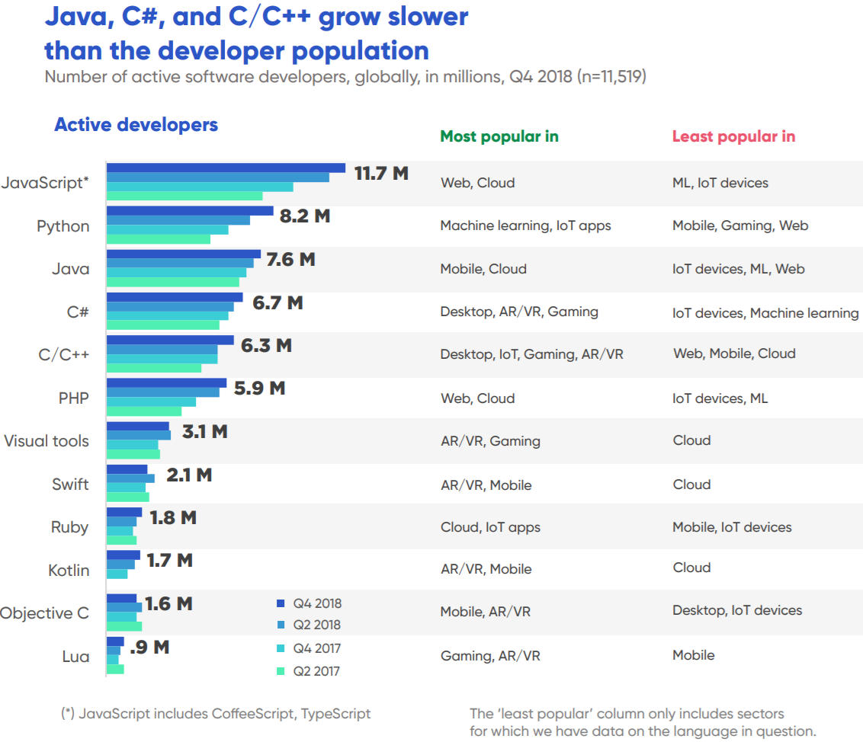
About Python – Trends

Slide 9
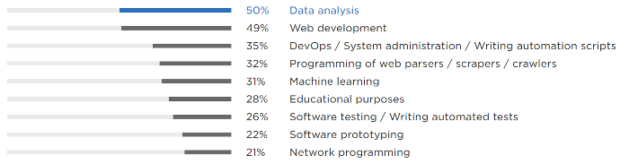
About Python – Jobs

Slide 10











About Python - Python Adaptors

Slide 11
Contents
About Python
Downloading and setting up python
Variables and Numbers
Data types
User Input
Operators and Expressions
Conditional Statements
Looping Structures
Lists, Tuples and Dictionaries
Type Conversions
Function declaration, calling functions and passing values, Function Returning values and Exiting from functions
Reading/Writing to File.

Slide 12
Downloading and setting up python
Download python from official python website: https://www.python.org/downloads/
For this course we will be using python version 3.x. So, download python 3.x version.
Download OS appropriate version x86 or x64.
While installing select add “PYTHON” to “PATH” variable.
For coding we will use pycharm community edition editor.
To check if python is installed, go to command prompt and type “python”. This will take you to python prompt. Press ctrl+z to exit.

Slide 13
Contents
About Python
Downloading and setting up python
Variables and Numbers
Data types
User Input
Operators and Expressions
Conditional Statements
Looping Structures
Lists, Tuples and Dictionaries
Type Conversions
Function declaration, calling functions and passing values, Function Returning values and Exiting from functions
Reading/Writing to File.

Slide 14
Variables and Numbers
There are two ways of using Python to run your program - using the interactive interpreter prompt or using a source file.
Using The Interpreter Prompt
print("Hello World")
2+3
X = 10
X+1
Print (x)
Y = 5
X+y
Type(x)

Slide 15
Variables and Numbers
Open a terminal window.
Change directory to where you saved the file, for example, cd /tmp/py.
Run the program by entering the command python hello.py.

Slide 16
Variables and Numbers
Help
If you need quick information about any function or statement in Python, then you can use the built-in help functionality.
This is very useful especially when using the interpreter prompt. For example, run help('len') - this displays the help for the len function which is used to count number of items.

Slide 17
Variables and Numbers
Commenting in python:
Only single line comments are allowed.
Use “#” without “” to comment a line.
explain assumptions
explain important decisions
explain important details
explain problems you're trying to solve
explain problems you're trying to overcome in your program, etc.

Slide 18
Variables and Numbers
Literal
An example of a literal constant is a number like 5, 1.23, or a string like 'This is a string' or "It's a string!".
It is called a literal because it is literal - you use its value literally. The number 2 always represents itself and nothing else - it is a constant because its value cannot be changed.
Hence, all these are referred to as literal constants.

Slide 19
Variables and Numbers
Numbers
Numbers are mainly of two types - integers and floats.
An example of an integer is 2 which is just a whole number.
Examples of floating point numbers (or floats for short) are 3.23 and 52.3E-4. The E notation indicates powers of 10. In this case, 52.3E-4 means 52.3 * 10^-4^.
There is no separate long type. The int type can be an integer of any size.

Slide 20
Variables and Numbers
Strings
A string is a sequence of characters. Strings are basically just a bunch of words.
You will be using strings in almost every Python program that you write, so pay attention to the following part.
Single Quote
You can specify strings using single quotes such as 'Quote me on this'.
All white space i.e. spaces and tabs, within the quotes, are preserved as-is.
Double Quote
Strings in double quotes work exactly the same way as strings in single quotes. An example is "What's your name?"

Slide 21
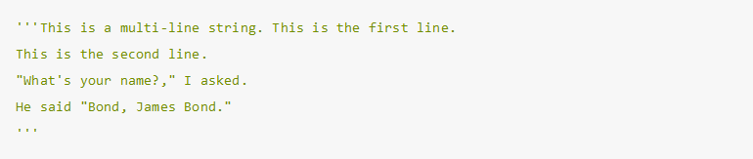
Variables and Numbers
Triple Quotes
You can specify multi-line strings using triple quotes - (""" or ''').
You can use single quotes and double quotes freely within the triple quotes. An example is:

Slide 22
Variables and Numbers
Strings Are Immutable
This means that once you have created a string, you cannot change it.
Although this might seem like a bad thing, it really isn't.
We will see why this is not a limitation in the various programs that we see later on.
There is no separate char data type in Python. There is no real need for it and I am sure you won't miss it.

Slide 23
Variables and Numbers
The format method
Sometimes we may want to construct strings from other information. This is where the format() method is useful.
age = 20
name = 'Swaroop'
print('{0} was {1} years old when he wrote this book'.format(name, age))
print('Why is {0} playing with phone?'.format(name))
O/P:
Swaroop was 20 years old when he wrote this book
Why is Swaroop playing with phone?
Alternative:
name + ' is ' + str(age) + ' years old'

Slide 24
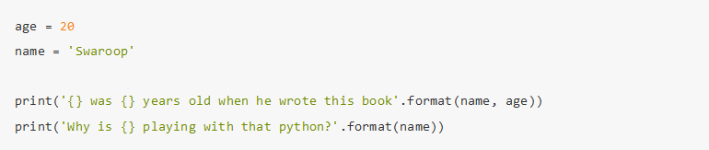
Variables and Numbers
Also note that the numbers are optional, so you could have also written as:

Slide 25
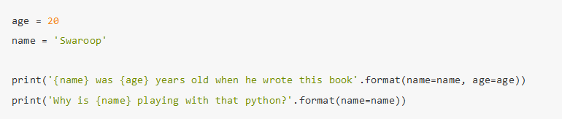
Variables and Numbers
We can also name the parameters:

Slide 26
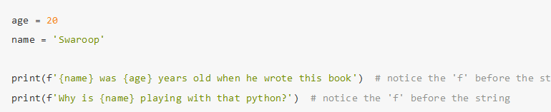
Variables and Numbers
Python 3.6 introduced a shorter way to do named parameters, called "f-strings":

Slide 27
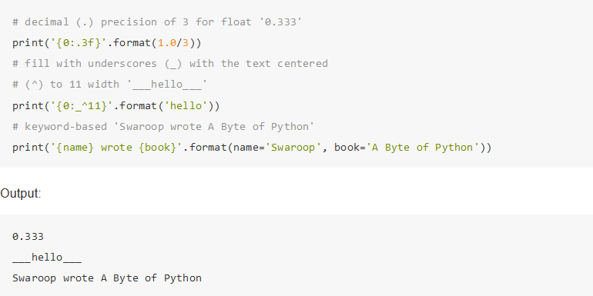
Variables and Numbers
More on format

Slide 28
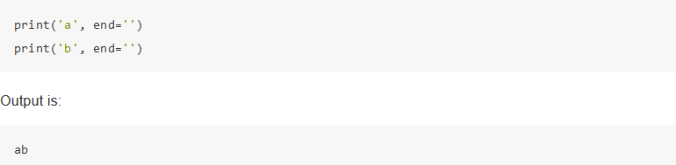
Variables and Numbers
Since we are discussing formatting, note that print always ends with an invisible "new line" character (\n) so that repeated calls to print will all print on a separate line each.
To prevent this newline character from being printed, you can specify that it should end with a blank:

Slide 29
Variables and Numbers
Escape Sequences
You specify the single quote as \' : notice the backslash. Now, you can specify the string as 'What\'s your name?'.
Another way of specifying this specific string would be "What's your name?" i.e. using double quotes. Similarly, you have to use an escape sequence for using a double quote itself in a double quoted string.
Also, you have to indicate the backslash itself using the escape sequence \\.

Slide 30
Variables and Numbers
Raw String
If you need to specify some strings where no special processing such as escape sequences are handled, then what you need is to specify a raw string by prefixing r or R to the string. An example is:
Always use raw strings when dealing with regular expressions. Otherwise, a lot of backwhacking may be required. For example, back references can be referred to as '\\1' or r'\1'.

Slide 31
Variables and Numbers
Using just literal constants can soon become boring - we need some way of storing any information and manipulate them as well.
This is where variables come into the picture. Variables are exactly what the name implies - their value can vary, i.e., you can store anything using a variable.
Variables are just parts of your computer's memory where you store some information.
Unlike literal constants, you need some method of accessing these variables and hence you give them names.

Slide 32
Variables and Numbers
Variable Naming
The first character of the identifier must be a letter of the alphabet (uppercase ASCII or lowercase ASCII or Unicode character) or an underscore (_).
The rest of the identifier name can consist of letters (uppercase ASCII or lowercase ASCII or Unicode character), underscores (_) or digits (0-9).
Identifier names are case-sensitive. For example, myname and myName are not the same.
Note the lowercase n in the former and the uppercase N in the latter.
Examples of valid identifier names are i, name_2_3. Examples of invalid identifier names are 2things, this is spaced out, my-name and >a1b2_c3.

Slide 33
Contents
About Python
Downloading and setting up python
Variables and Numbers
Data types
User Input
Operators and Expressions
Conditional Statements
Looping Structures
Lists, Tuples and Dictionaries
Type Conversions
Function declaration, calling functions and passing values, Function Returning values and Exiting from functions
Reading/Writing to File.

Slide 34
Data types
Variables can hold values of different types called data types.
The basic types are numbers and strings, which we have already discussed.
We will see how to create our own types using classes.

Slide 35
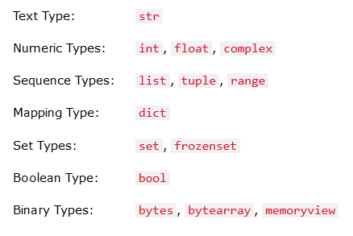
Data types

Slide 36
Data types
Object
Remember, Python refers to anything used in a program as an object.
This is meant in the generic sense. Instead of saying "the something"', we say "the object".
Python is strongly object-oriented in the sense that everything is an object including numbers, strings and function

Slide 37
Data types
Logical And Physical Line
A physical line is what you see when you write the program. A logical line is what Python sees as a single statement. Python implicitly assumes that each physical line corresponds to a logical line.
An example of a logical line is a statement like print('hello world') - if this was on a line by itself (as you see it in an editor), then this also corresponds to a physical line.
Implicitly, Python encourages the use of a single statement per line which makes code more readable.
If you want to specify more than one logical line on a single physical line, then you have to explicitly specify this using a semicolon (;) which indicates the end of a logical line/statement.

Slide 38


Data types
Logical And Physical Line
=
=
=

Slide 39
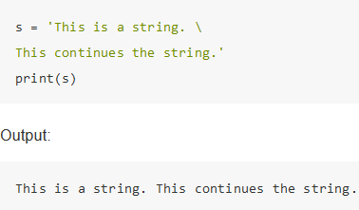
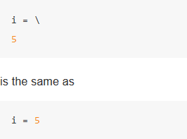
Data types
if you have a long line of code, you can break it into multiple physical lines by using the backslash.
This is referred to as explicit line joining:

Slide 40
Data types
Indentation
Whitespace is important in Python.
Actually, whitespace at the beginning of the line is important.
This is called indentation.
Leading whitespace (spaces and tabs) at the beginning of the logical line is used to determine the indentation level of the logical line, which in turn is used to determine the grouping of statements.
This means that statements which go together must have the same indentation. Each such set of statements is called a block.

Slide 41
Contents
About Python
Downloading and setting up python
Variables and Numbers
Data types
User Input
Operators and Expressions
Conditional Statements
Looping Structures
Lists, Tuples and Dictionaries
Type Conversions
Function declaration, calling functions and passing values, Function Returning values and Exiting from functions
Reading/Writing to File.

Slide 42
User Input
Version 3.6
Version 2.7

Slide 43
Contents
About Python
Downloading and setting up python
Variables and Numbers
Data types
User Input
Operators and Expressions
Conditional Statements
Looping Structures
Lists, Tuples and Dictionaries
Type Conversions
Function declaration, calling functions and passing values, Function Returning values and Exiting from functions
Reading/Writing to File.

Slide 44
Operators and Expressions
Most statements (logical lines) that you write will contain expressions.
A simple example of an expression is 2 + 3.
An expression can be broken down into operators and operands.
Operators are functionality that do something and can be represented by symbols such as + or by special keywords.
Operators require some data to operate on and such data is called operands.
In this case, 2 and 3 are the operands.

Slide 45
Operators and Expressions
Operators
+ (plus): Adds two object
- (minus): Gives the subtraction of one number from the other; if the first operand is absent it is assumed to be zero.
* (multiply): Gives the multiplication of the two numbers or returns the string repeated that many times.
** (power): Returns x to the power of y
/ (divide): Divide x by y
// (divide and floor): Divide x by y and round the answer down to the nearest integer value. Note that if one of the values is a float, you'll get back a float.
% (modulo): Returns the remainder of the division

Slide 46
Operators and Expressions
<< (left shift): Shifts the bits of the number to the left by the number of bits specified.
>> (right shift): Shifts the bits of the number to the right by the number of bits specified.
& (bit-wise AND): Bit-wise AND of the numbers.
| (bit-wise OR): Bitwise OR of the numbers.
^ (bit-wise XOR): Bitwise XOR of the numbers
~ (bit-wise invert): The bit-wise inversion of x is -(x+1)
< (less than): Returns whether x is less than y. All comparison operators return True or False. Note the capitalization of these names.

Slide 47
Operators and Expressions
> (greater than): Returns whether x is greater than y.
<= (less than or equal to): Returns whether x is less than or equal to y.
>= (greater than or equal to): Returns whether x is greater than or equal to y.
== (equal to): Compares if the objects are equal.
!= (not equal to): Compares if the objects are not equal.
not (boolean NOT): If x is True, it returns False. If x is False, it returns True.
and (boolean AND): x and y returns False if x is False, else it returns evaluation of y
or (boolean OR): If x is True, it returns True, else it returns evaluation of y

Slide 48
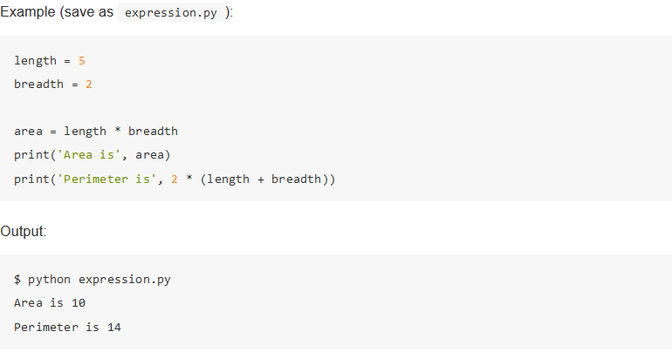
Operators and Expressions
Expressions

Slide 49
Contents
About Python
Downloading and setting up python
Variables and Numbers
Data types
User Input
Operators and Expressions
Conditional Statements
Looping Structures
Lists, Tuples and Dictionaries
Type Conversions
Function declaration, calling functions and passing values, Function Returning values and Exiting from functions
Reading/Writing to File.

Slide 50
Conditional Statements
In the programs we have seen till now, there has always been a series of statements faithfully executed by Python in exact top-down order.
What if you wanted to change the flow of how it works? For example, you want the program to take some decisions and do different things depending on different situations, such as printing 'Good Morning' or 'Good Evening' depending on the time of the day?
As you might have guessed, this is achieved using control flow statements.
There are three control flow statements in Python - if, for and while.

Slide 51
Conditional Statements
The if statement
The if statement is used to check a condition: if the condition is true, we run a block of statements (called the if-block), else we process another block of statements (called the else-block).
The else clause is optional.

Slide 52
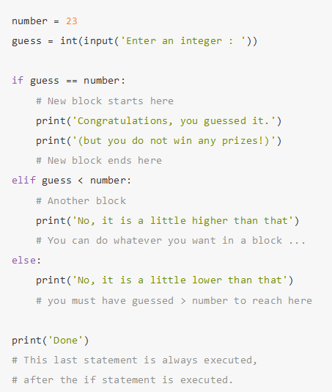
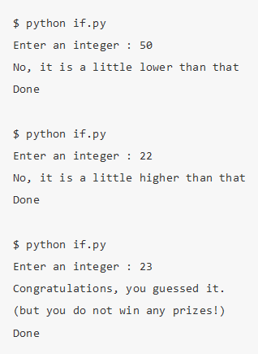
Conditional Statements

Slide 53
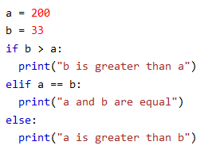
Conditional Statements
Else
The else keyword catches anything which isn't caught by the preceding conditions.

Slide 54
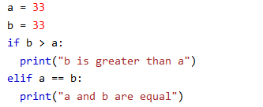
Conditional Statements
Elif
The elif keyword is pythons way of saying "if the previous conditions were not true, then try this condition“.

Slide 55
Conditional Statements
Short Hand If
If you have only one statement to execute, you can put it on the same line as the if statement.

Slide 56
Conditional Statements
Short Hand If ... Else
If you have only one statement to execute, one for if, and one for else, you can put it all on the same line:

Slide 57
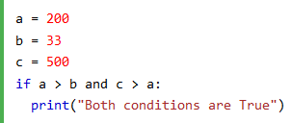
Conditional Statements
And

Slide 58
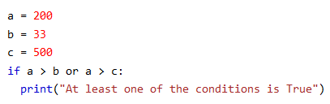
Conditional Statements
Or

Slide 59
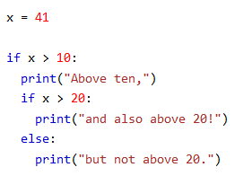
Conditional Statements
Nested If

Slide 60
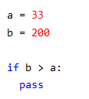
Conditional Statements
The pass Statement
if statements cannot be empty, but if you for some reason have an if statement with no content, put in the pass statement to avoid getting an error.

Slide 61
Contents
About Python
Downloading and setting up python
Variables and Numbers
Data types
User Input
Operators and Expressions
Conditional Statements
Looping Structures
Lists, Tuples and Dictionaries
Type Conversions
Function declaration, calling functions and passing values, Function Returning values and Exiting from functions
Reading/Writing to File.

Slide 62
Looping Structures
The while Statement
The while statement allows you to repeatedly execute a block of statements as long as a condition is true.
A while statement is an example of what is called a looping statement.
A while statement can have an optional else clause.

Slide 63
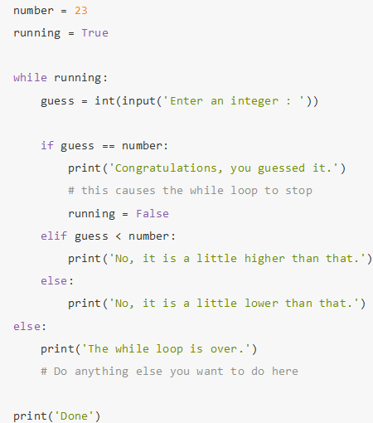
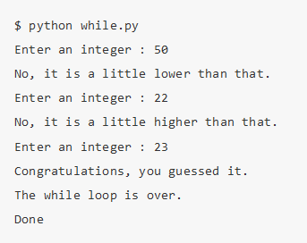
Looping Structures

Slide 64
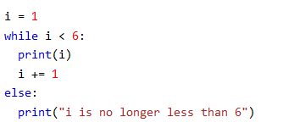
The else Statement:
With the else statement we can run a block of code once when the condition no longer is true.

Slide 65
Looping Structures
The for loop
The for..in statement is another looping statement which iterates over a sequence of objects i.e. go through each item in a sequence.
We will see more about sequences in detail in later chapters.
What you need to know right now is that a sequence is just an ordered collection of items.

Slide 66
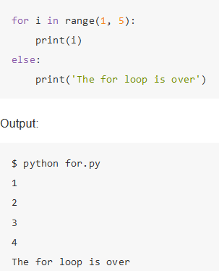
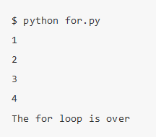
Looping Structures

Slide 67
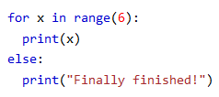
Looping Structures
Else in For Loop
The else keyword in a for loop specifies a block of code to be executed when the loop is finished

Slide 68
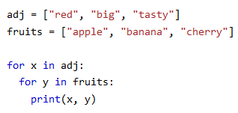
Looping Structures
Nested Loops

Slide 69
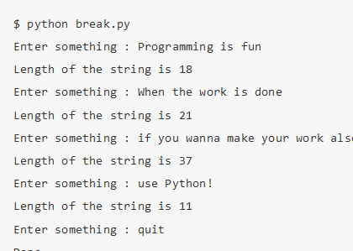
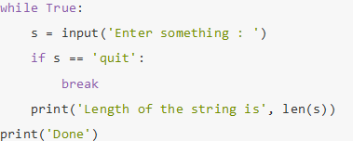
Looping Structures
The break Statement
The break statement is used to break out of a loop statement i.e. stop the execution of a looping statement, even if the loop condition has not become False or the sequence of items has not been completely iterated over.
An important note is that if you break out of a for or while loop, any corresponding loop else block is not executed.

Slide 70
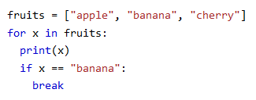
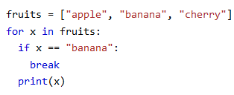

Slide 71
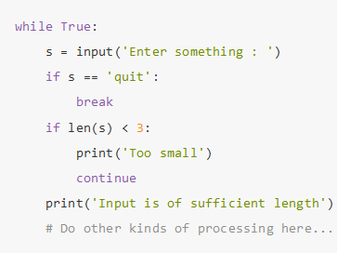
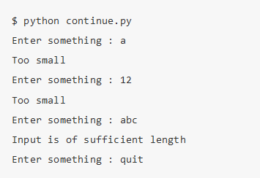
Looping Structures
The continue Statement
The continue statement is used to tell Python to skip the rest of the statements in the current loop block and to continue to the next iteration of the loop.

Slide 72

Looping Structures
Looping Through a String

Slide 73


Looping Structures
range() Function
To loop through a set of code a specified number of times, we can use the range() function.
The range() function returns a sequence of numbers, starting from 0 by default, and increments by 1 (by default), and ends at a specified number.

Slide 74
Contents
About Python
Downloading and setting up python
Variables and Numbers
Data types
User Input
Operators and Expressions
Conditional Statements
Looping Structures
Lists, Tuples and Dictionaries
Type Conversions
Function declaration, calling functions and passing values, Function Returning values and Exiting from functions
Reading/Writing to File.

Slide 75
Lists, Tuples and Dictionaries
There are 4 types of collections (array) in python.
List is a collection which is ordered and changeable. Allows duplicate members.
Tuple is a collection which is ordered and unchangeable. Allows duplicate members.
Set is a collection which is unordered and unindexed. No duplicate members.
Dictionary is a collection which is unordered, changeable and indexed. No duplicate members.
When choosing a collection type, it is useful to understand the properties of that type. Choosing the right type for a particular data set could mean retention of meaning, and, it could mean an increase in efficiency or security.

Slide 76
Lists, Tuples and Dictionaries
List
A list is a collection which is ordered and changeable.
In Python lists are written with square brackets.

Slide 77
Lists, Tuples and Dictionaries
List – Access Item
You access the list items by referring to the index number

Slide 78
Lists, Tuples and Dictionaries
List – Negative Indexing
Negative indexing means beginning from the end, -1 refers to the last item, -2 refers to the second last item etc.

Slide 79
Lists, Tuples and Dictionaries
List – Range of Indexes
You can specify a range of indexes by specifying where to start and where to end the range.
When specifying a range, the return value will be a new list with the specified items.

Slide 80
Lists, Tuples and Dictionaries
List – Range of Indexes
By leaving out the start value, the range will start at the first item:

Slide 81
Lists, Tuples and Dictionaries
List – Range of Indexes
By leaving out the end value, the range will go on to the end of the list:

Slide 82
Lists, Tuples and Dictionaries
List – Range of Negative Indexes
Specify negative indexes if you want to start the search from the end of the list:

Slide 83
Lists, Tuples and Dictionaries
List – Change item value
To change the value of a specific item, refer to the index number:

Slide 84
Lists, Tuples and Dictionaries
List – Loop through a list
You can loop through the list items by using a for loop:

Slide 85
Lists, Tuples and Dictionaries
List – Check if item exists
To determine if a specified item is present in a list use the in keyword:

Slide 86
Lists, Tuples and Dictionaries
List Length
To determine how many items a list has, use the len() function:

Slide 87
Lists, Tuples and Dictionaries
List – Add item
To add an item to the end of the list, use the append() method:

Slide 88
Lists, Tuples and Dictionaries
List – Add item
To add an item at the specified index, use the insert() method:

Slide 89
Lists, Tuples and Dictionaries
List – Remove item
There are several methods to remove items from a list:

Slide 90
Lists, Tuples and Dictionaries
List – Remove item at specific index
To remove an item at the specified index, use the pop() method
The last item if index is not specified

Slide 91
Lists, Tuples and Dictionaries
List – Remove item at specific index
The del keyword removes the specified index

Slide 92
Lists, Tuples and Dictionaries
List – Remove item at specific index
The clear() method empties the list

Slide 93
Lists, Tuples and Dictionaries
List – Copy a list
You cannot copy a list simply by typing list2 = list1, because: list2 will only be a reference to list1, and changes made in list1 will automatically also be made in list2.
There are ways to make a copy, one way is to use the built-in List method copy().

Slide 94
Lists, Tuples and Dictionaries
List – Copy a list
Another way to make a copy is to use the built-in method list().

Slide 95
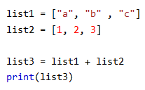
Lists, Tuples and Dictionaries
List – Join two lists
There are several ways to join, or concatenate, two or more lists in Python.
One of the easiest ways are by using the + operator.

Slide 96
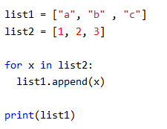
Lists, Tuples and Dictionaries
List – Join two lists
Another way to join two lists are by appending all the items from list2 into list1, one by one:

Slide 97
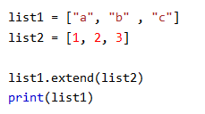
Lists, Tuples and Dictionaries
List – Join two lists
Or you can use the extend() method, which purpose is to add elements from one list to another list:

Slide 98
Lists, Tuples and Dictionaries
List – The list() constructor
It is also possible to use the list() constructor to make a new list.

Slide 99
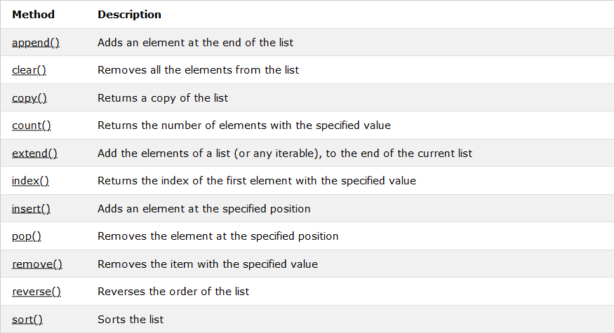
Lists, Tuples and Dictionaries

Slide 100
Lists, Tuples and Dictionaries
Tuple
A tuple is a collection which is ordered and unchangeable.
In Python tuples are written with round brackets.

Slide 101
Lists, Tuples and Dictionaries
Tuple – Access tuple items
You can access tuple items by referring to the index number, inside square brackets:

Slide 102
Lists, Tuples and Dictionaries
Tuple – Negative Indexing
Negative indexing means beginning from the end, -1 refers to the last item, -2 refers to the second last item etc.

Slide 103
Lists, Tuples and Dictionaries
Tuple – Range of Indexes
You can specify a range of indexes by specifying where to start and where to end the range.
When specifying a range, the return value will be a new tuple with the specified items.

Slide 104
Lists, Tuples and Dictionaries
Tuple – Range of Negative Indexes
Specify negative indexes if you want to start the search from the end of the tuple:

Slide 105
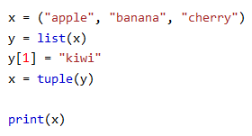
Lists, Tuples and Dictionaries
Tuple – Change Tuple Values
Once a tuple is created, you cannot change its values. Tuples are unchangeable, or immutable as it also is called.
But there is a workaround. You can convert the tuple into a list, change the list, and convert the list back into a tuple.

Slide 106
Lists, Tuples and Dictionaries
Tuple – Loop Through a Tuple
You can loop through the tuple items by using a for loop.

Slide 107
Lists, Tuples and Dictionaries
Tuple – Check if Item Exists
To determine if a specified item is present in a tuple use the in keyword:

Slide 108
Lists, Tuples and Dictionaries
Tuple – Tuple Length
To determine how many items a tuple has, use the len() method:

Slide 109
Lists, Tuples and Dictionaries
Tuple – Add Items
Once a tuple is created, you cannot add items to it. Tuples are unchangeable.

Slide 110
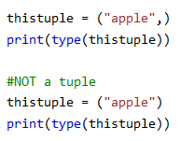
Lists, Tuples and Dictionaries
Tuple – Create Tuple With One Item
To create a tuple with only one item, you have add a comma after the item, unless Python will not recognize the variable as a tuple.

Slide 111
Lists, Tuples and Dictionaries
Tuple – Remove Items
Tuples are unchangeable, so you cannot remove items from it, but you can delete the tuple completely

Slide 112
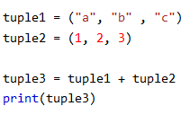
Lists, Tuples and Dictionaries
Tuple – Join Two Tuples
To join two or more tuples you can use the + operator:

Slide 113
Lists, Tuples and Dictionaries
Tuple – The tuple() Constructor
It is also possible to use the tuple() constructor to make a tuple.

Slide 114
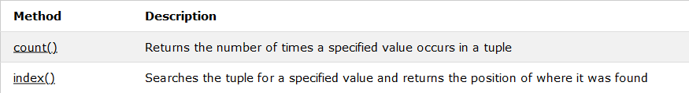
Lists, Tuples and Dictionaries
Tuple – Tuple Methods

Slide 115
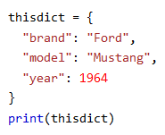
Lists, Tuples and Dictionaries
Dictionary
A dictionary is a collection which is unordered, changeable and indexed.
In Python dictionaries are written with curly brackets, and they have keys and values.

Slide 116
Lists, Tuples and Dictionaries
Dictionary – Accessing items
You can access the items of a dictionary by referring to its key name, inside square brackets:

Slide 117
Lists, Tuples and Dictionaries
Dictionary – Accessing items
There is also a method called get() that will give you the same result:

Slide 118
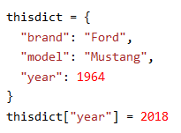
Lists, Tuples and Dictionaries
Dictionary – Change Values
You can change the value of a specific item by referring to its key name:

Slide 119
Lists, Tuples and Dictionaries
Dictionary – Loop Through a Dictionary
You can loop through a dictionary by using a for loop.
When looping through a dictionary, the return value are the keys of the dictionary, but there are methods to return the values as well.

Slide 120
Lists, Tuples and Dictionaries
Dictionary – Loop Through a Dictionary

Slide 121
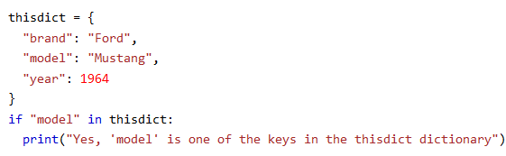
Lists, Tuples and Dictionaries
Dictionary – Check if Key Exists
To determine if a specified key is present in a dictionary use the in keyword

Slide 122
Lists, Tuples and Dictionaries
Dictionary – Dictionary Length
To determine how many items (key-value pairs) a dictionary has, use the len() method.

Slide 123
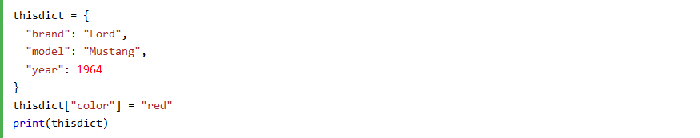
Lists, Tuples and Dictionaries
Dictionary – Adding Items
Adding an item to the dictionary is done by using a new index key and assigning a value to it:

Slide 124
Lists, Tuples and Dictionaries
Dictionary – Adding Items
Adding an item to the dictionary is done by using a new index key and assigning a value to it:

Slide 125
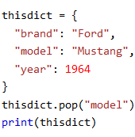
Lists, Tuples and Dictionaries
Dictionary – Removing Items
There are several methods to remove items from a dictionary:

Slide 126
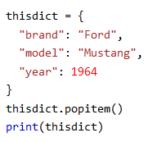
Lists, Tuples and Dictionaries
Dictionary – Removing Items
The popitem() method removes the last inserted item (in versions before 3.7, a random item is removed instead):

Slide 127

Lists, Tuples and Dictionaries
Dictionary – Removing Items
The del keyword removes the item with the specified key name:

Slide 128
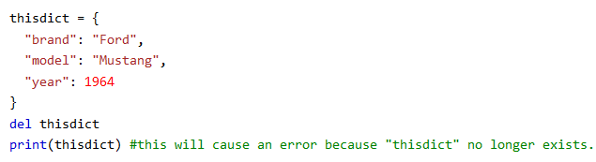
Lists, Tuples and Dictionaries
Dictionary – Removing Items
The del keyword can also delete the dictionary completely:

Slide 129
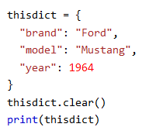
Lists, Tuples and Dictionaries
Dictionary – Removing Items
The clear() keyword empties the dictionary:

Slide 130
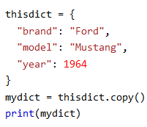
Lists, Tuples and Dictionaries
Dictionary – Copy a Dictionary
You cannot copy a dictionary simply by typing dict2 = dict1, because: dict2 will only be a reference to dict1, and changes made in dict1 will automatically also be made in dict2.
There are ways to make a copy, one way is to use the built-in Dictionary method copy().

Slide 131

Lists, Tuples and Dictionaries
Dictionary – Copy a Dictionary
Another way to make a copy is to use the built-in method dict().

Slide 132

Lists, Tuples and Dictionaries
Dictionary – Nested Dictionaries
A dictionary can also contain many dictionaries, this is called nested dictionaries.

Slide 133

Lists, Tuples and Dictionaries
Dictionary – Nested Dictionaries
Or, if you want to nest three dictionaries that already exists as dictionaries:

Slide 134

Lists, Tuples and Dictionaries
Dictionary – The dict() Constructor
It is also possible to use the dict() constructor to make a new dictionary:

Slide 135

Lists, Tuples and Dictionaries

Slide 136
Contents
About Python
Downloading and setting up python
Variables and Numbers
Data types
User Input
Operators and Expressions
Conditional Statements
Looping Structures
Lists, Tuples and Dictionaries
Type Conversions
Function declaration, calling functions and passing values, Function Returning values and Exiting from functions
Reading/Writing to File.

Slide 137
Type Conversions
Specify a Variable Type
There may be times when you want to specify a type on to a variable.
This can be done with casting.
Python is an object-orientated language, and as such it uses classes to define data types, including its primitive types.
Casting in python is therefore done using constructor functions:

Slide 138
Type Conversions
int() - constructs an integer number from an integer literal, a float literal (by rounding down to the previous whole number), or a string literal (providing the string represents a whole number)
float() - constructs a float number from an integer literal, a float literal or a string literal (providing the string represents a float or an integer)
str() - constructs a string from a wide variety of data types, including strings, integer literals and float literals

Slide 139

Type Conversions

Slide 140
Contents
About Python
Downloading and setting up python
Variables and Numbers
Data types
User Input
Operators and Expressions
Conditional Statements
Looping Structures
Lists, Tuples and Dictionaries
Type Conversions
Function declaration, calling functions and passing values, Function Returning values and Exiting from functions
Reading/Writing to File.

Slide 141
Function declaration, calling functions and passing values, Function Returning values and Exiting from functions
A function is a block of code which only runs when it is called.
You can pass data, known as parameters, into a function.
A function can return data as a result.

Slide 142
Function declaration, calling functions and passing values, Function Returning values and Exiting from functions
Creating a Function
In Python a function is defined using the def keyword:

Slide 143

Function declaration, calling functions and passing values, Function Returning values and Exiting from functions
Calling a Function
To call a function, use the function name followed by parenthesis:

Slide 144
Function declaration, calling functions and passing values, Function Returning values and Exiting from functions
Information can be passed to functions as parameter.
Parameters are specified after the function name, inside the parentheses.
You can add as many parameters as you want, just separate them with a comma.
The following example has a function with one parameter (fname).
When the function is called, we pass along a first name, which is used inside the function to print the full name:

Slide 145

Function declaration, calling functions and passing values, Function Returning values and Exiting from functions

Slide 146

Function declaration, calling functions and passing values, Function Returning values and Exiting from functions
The following example shows how to use a default parameter value.
If we call the function without parameter, it uses the default value:

Slide 147

Function declaration, calling functions and passing values, Function Returning values and Exiting from functions
You can send any data types of parameter to a function (string, number, list, dictionary etc.), and it will be treated as the same data type inside the function.
E.g. if you send a List as a parameter, it will still be a List when it reaches the function:

Slide 148

Function declaration, calling functions and passing values, Function Returning values and Exiting from functions
To let a function return a value, use the return statement:

Slide 149

Function declaration, calling functions and passing values, Function Returning values and Exiting from functions
You can also send arguments with the key = value syntax.
This way the order of the arguments does not matter.

Slide 150

Function declaration, calling functions and passing values, Function Returning values and Exiting from functions
If you do not know how many arguments that will be passed into your function, add a * before the parameter name in the function definition.
This way the function will receive a tuple of arguments, and can access the items accordingly:

Slide 151
Function declaration, calling functions and passing values, Function Returning values and Exiting from functions
function definitions cannot be empty, but if you for some reason have a function definition with no content, put in the pass statement to avoid getting an error.

Slide 152
Function declaration, calling functions and passing values, Function Returning values and Exiting from functions
Python also accepts function recursion, which means a defined function can call itself.
Recursion is a common mathematical and programming concept. It means that a function calls itself.
This has the benefit of meaning that you can loop through data to reach a result.
The developer should be very careful with recursion as it can be quite easy to slip into writing a function which never terminates, or one that uses excess amounts of memory or processor power.
However, when written correctly recursion can be a very efficient and mathematically-elegant approach to programming.

Slide 153

Function declaration, calling functions and passing values, Function Returning values and Exiting from functions

Slide 154
Contents
About Python
Downloading and setting up python
Variables and Numbers
Data types
User Input
Operators and Expressions
Conditional Statements
Looping Structures
Lists, Tuples and Dictionaries
Type Conversions
Function declaration, calling functions and passing values, Function Returning values and Exiting from functions
Reading/Writing to File.

Slide 155
Reading/Writing to File.
Python has several functions for creating, reading, updating, and deleting files.
The key function for working with files in Python is the open() function.
The open() function takes two parameters; filename, and mode.
There are four different methods (modes) for opening a file:

Slide 156
Reading/Writing to File.
"r" - Read - Default value. Opens a file for reading, error if the file does not exist
"a" - Append - Opens a file for appending, creates the file if it does not exist
"w" - Write - Opens a file for writing, creates the file if it does not exist
"x" - Create - Creates the specified file, returns an error if the file exists
In addition you can specify if the file should be handled as binary or text mode
"t" - Text - Default value. Text mode
"b" - Binary - Binary mode (e.g. images)

Slide 157
Reading/Writing to File.
To open a file for reading it is enough to specify the name of the file:
=

Slide 158
Reading/Writing to File.
Open a File
To open the file, use the built-in open() function.
The open() function returns a file object, which has a read() method for reading the content of the file:

Slide 159
Reading/Writing to File.
Read Only Parts of the File
By default the read() method returns the whole text, but you can also specify how many characters you want to return:

Slide 160
Reading/Writing to File.
Read Lines
You can return one line by using the readline() method:

Slide 161
Reading/Writing to File.
Read Lines
By calling readline() two times, you can read the two first lines:

Slide 162
Reading/Writing to File.
Read Lines
By looping through the lines of the file, you can read the whole file, line by line:

Slide 163
Reading/Writing to File.
Close Files
It is a good practice to always close the file when you are done with it.

Slide 164

Reading/Writing to File.
Write to an Existing File
To write to an existing file, you must add a parameter to the open() function:
"a" - Append - will append to the end of the file
"w" - Write - will overwrite any existing content

Slide 165

Reading/Writing to File.
Open the file "demofile3.txt" and overwrite the content:

Slide 166
Reading/Writing to File.
Create a New File
To create a new file in Python, use the open() method, with one of the following parameters:
"x" - Create - will create a file, returns an error if the file exist
"a" - Append - will create a file if the specified file does not exist
"w" - Write - will create a file if the specified file does not exis

Slide 167
Reading/Writing to File.
Create a file called "myfile.txt":
Create a new file if it does not exist:

Slide 168
Reading/Writing to File.
Delete a File
To delete a file, you must import the OS module, and run its os.remove() function:

Slide 169

Reading/Writing to File.
To avoid getting an error, you might want to check if the file exists before you try to delete it:

Slide 170
Reading/Writing to File.
Delete Folder
To delete an entire folder, use the os.rmdir() method:

